Slide 1
What Goes Into the Assignment
Maria Lemac

Slide 2
Assignment…
What needs to be done and put into the report…

Slide 3
Requirements Analysis and Design
Users – roles
Use case diagram – functionalities / features
Class diagram – data stored
Navigation diagram
Design – presentation model

Slide 4
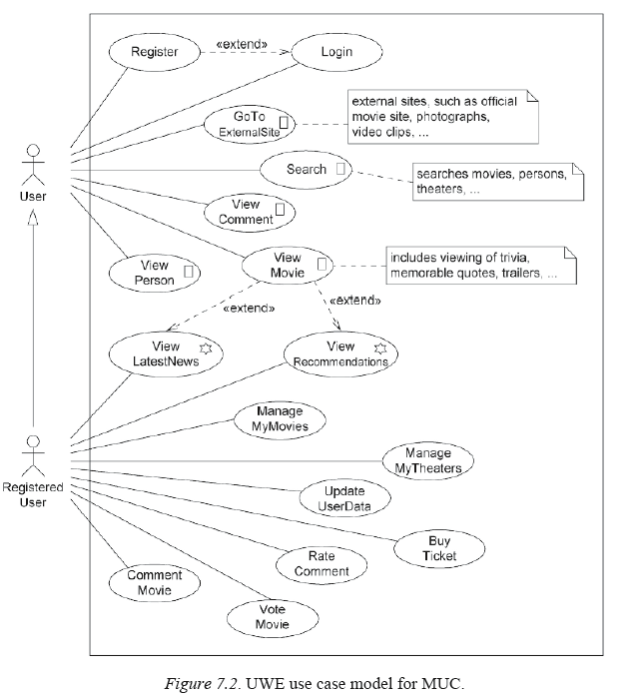

Slide 5
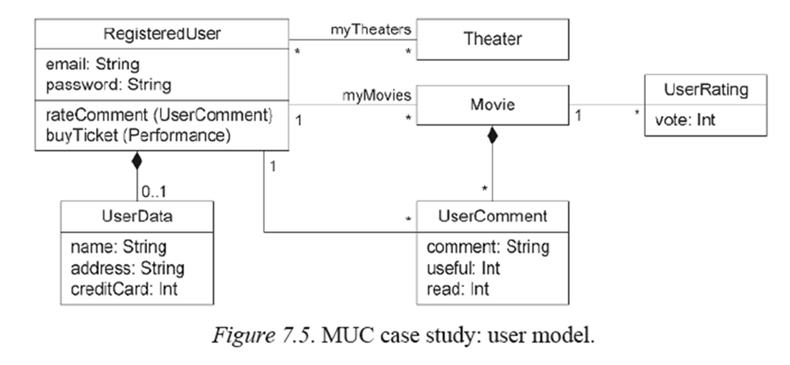
User Model
The user model contains the user data needed for the login of the user and the comments and rating of the movies.
All these data are provided by the users themselves during registration or use of the Web application.

Slide 6
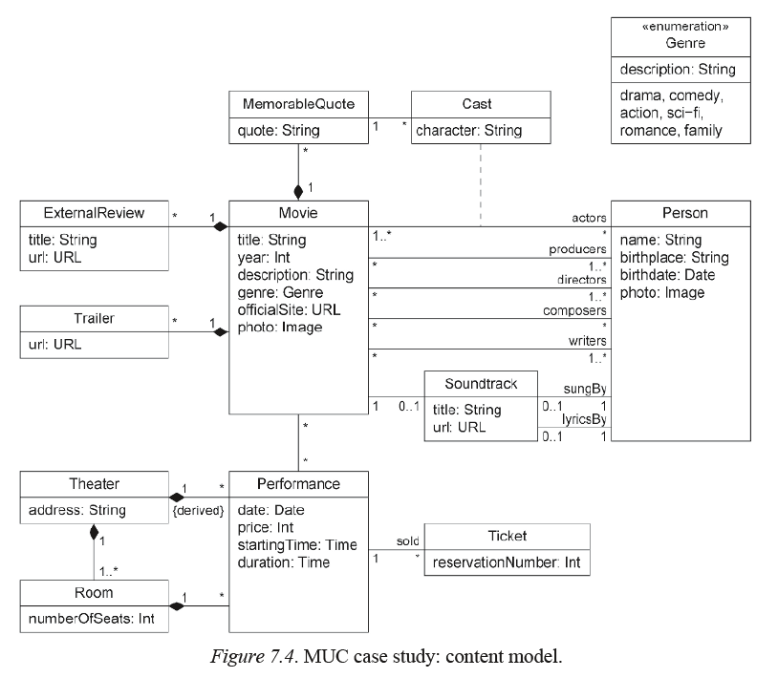
The content model of IMDb

Slide 7
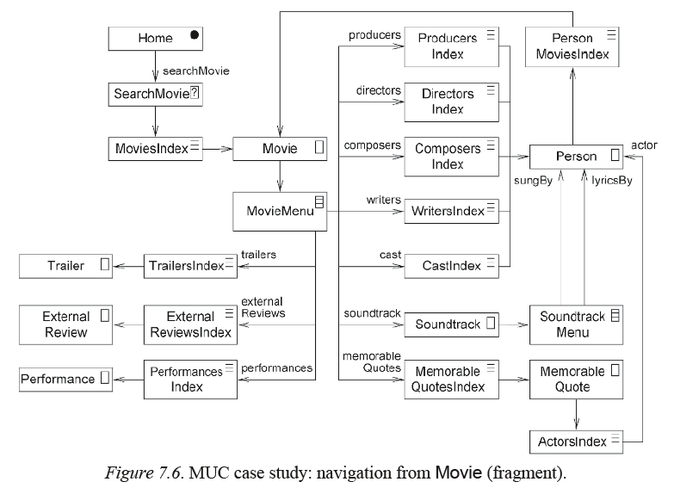

Slide 8
… and Design
The role of the interface is to make the navigation objects and application functionality perceptible to the user, which is the goal of the interface design.

Slide 9
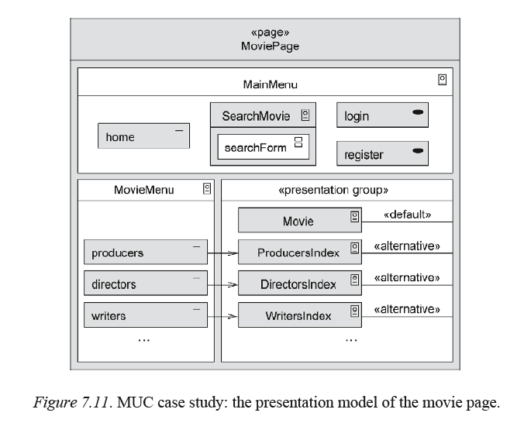

Slide 10
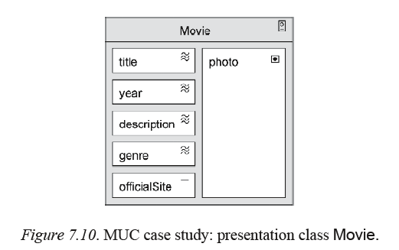

Slide 11
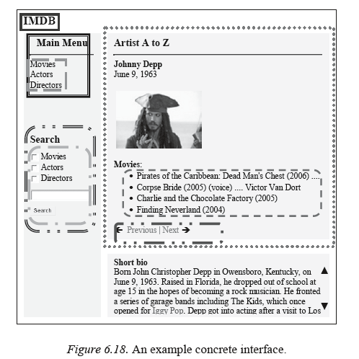
Interface Design IMDb

Slide 12
Main Implementation: Connect to Database
XAMPP
Apache and phpMyAdmin need to be running
htdocs – folder needs to be used for your site folders/files
phpMyAdmin
Show the database and tables created

Slide 13
Implementation
Implement basic structure using html and css (abstract design) so that you can implement functionalities
Use of html and css is not separately assessed and you do not need to explain how you have used it unless it is part of the functionality
Most of the marks come from…
Completion and explanation of the main implementation tasks plus the extended implementation.

Slide 14
Main Implementation: Enter Form Data to Database
“Collect data from a form and enter it into a table of your database.” - is used to implement the following use case:
User Case / Functionality: “Create Classes”
User Case / Functionality: “Create Profiles”
User Case / Functionality: “Apply for Lecturer”
“Anyone can apply to become a lecturer. An application form needs to be filled in and submitted. The information from the form needs to be collected and entered into an appropriate table of the database.”
Are there any other use cases (functionalities) that can be implemented using the same technique?
Files:
example.php
example1.php (form included)
applyLec.html

Slide 15
Main Implementation: Display / Retrieve Data from Database
User Case / Functionality: “View Classes”
User Case / Functionality: “View Applications”
User Case / Functionality: “View Profiles”
“Classes or Applications have been stored in the database and these can be retrieved from the database table and displayed on a page for any appropriate roles to view.”
Are there any other use cases (functionalities) that can be implemented using the same technique?

Slide 16
Main Implementation:
Display / Retrieve Selected Data from Database
“All or selected data from the database can be retrieved and displayed on a page.”
User Case / Functionality: any “View …” use case
“A list of applications that have been stored in the database can be retrieved as a list with reduced details and displayed on a page for a manager to view.”
Are there any other use cases (functionalities) that can be implemented using the same technique?

Slide 17
Main Implementation:
Upload Images
“Images can be uploaded where appropriate.”
User Case / Functionality: “Create Profile”
“Lecturers can create their profile and upload an image”
Are there any other use cases (functionalities) that can be implemented using the same technique?

